Slide 1

New Life Medicals Group of Companies Overview

Slide 2
NLM Group Overview
Founder Director
Group CEO
Employees
Ankit Shah
Dr. Dipankar Dutta
25+
Consolidated Subsidiaries
3
Global Operating Base
Ahmedabad ( India )
North Carolina ( USA )
Dublin Ireland ( Europe
Global Supply Chain Hubs
North Carolina
Dublin Ireland
Canada
Tokyo
Toronto
Perth Australia
Sao Paolo Brazil
* For Irish Subsidiary ie New Life Biopharma Limited

Slide 3
NLM’s Evolution
Partner CTSS
Merchant Exporter
Supplier RLD
Across the Globe
Retail Pharmacy
Asia Pacific Region
World Wide
Ahmedabad India

Slide 4
NewLife Medicals Group Entities
Subsidiary Office Raleigh, NC,US
2021
Focussed on Comparator Drug Sourcing, Serving US & ROW Markets; CTSS activities
No 2 US RLD supplying Company in India
Head Office Ahmedabad, India
2014
Focussed on Exports (FDF,API etc)
Marketing own Brand in Maldives & Cambodia
Supplying API’s to SAARC, SEA, Africa, LATAM markets
Subsidiary Office Dublin, Ireland
2022
Focussed on Comparator Drug Sourcing, Serving European & ROW Markets
No 3 Europe RLD supplying Company in India

Slide 5
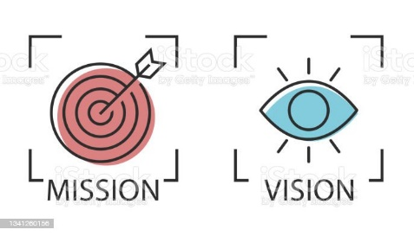
Our Vision & Mission
VISION
At NewLife Medicals, we work every day to grow as an Admired Global Company that makes a difference in people’s life.
MISSION
Our mission is to enable people lead Good Life, Happy Life and Longer Life.

Slide 6





Our Core Value’s
Empowerment and Empathy
We think through our heart, we do the right thing and we have the commitment to own the outcome
Clients first
Each of us, no matter what we do, contributes to the development of every function that ultimately benefits client
On Time Service
From the smallest detail to the largest, we take service seriously. We focus on the detail while never losing sight of the big picture to drive the best possible outcome
Respect
We recognize and uphold the importance of all people, the way we do things, our quest for innovation and most importantly, our clients

Slide 7
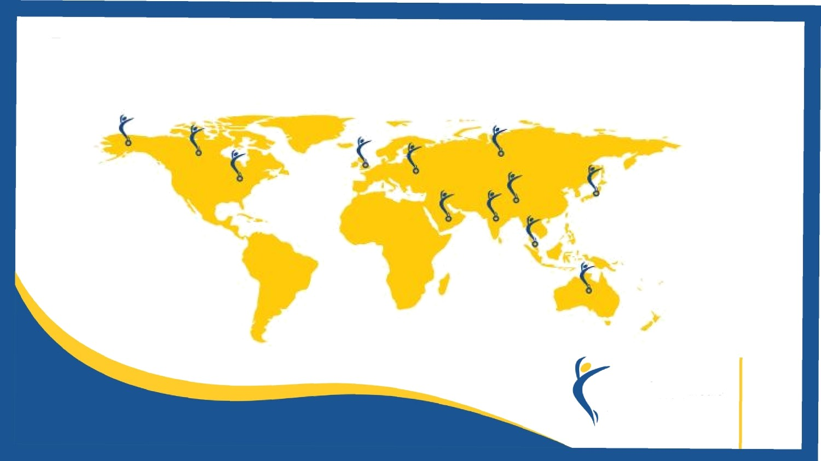
Our Global Presence
Asia Pacific
USA
Europe
Latam
Mena
SAARC

Slide 8




Approved by
2016
WDL Pennsylvania
2022(Mar)
WDL North Carolina
2022(May)
WS MOH, UAE
2022(Aug)
WDL HPRA, Ireland
2022(Apr)
3PL North Carolina
- Received State License's in first instance without any review
- North Carolina warehouse underwent 1st random inspection in Aug and was cleared
without any critical findings
Data on File

Slide 9
Proven Track Record
30
Direct Access with Manufacturers
2 & 3 US & Europe RLD’s in Indian Market
50
Pharma Companies received ANDA/MA based on RLD supplied
5
Serving Client base across Continents
5
NLM Brand Registered
Data on File

Slide 10
Core Capability Matrix
 |  |  | Clinical Trial Sourcing
NewLife Medicals Group Entities | Location | Region | Comparator / RLD Drug Sourcing | Ancilliary Supplies | REMs Access | Source/ Access |  | DTP | DTS | CT/ RMP Supplies | Return/ Reconciliation/Destruction
 |  |  |  |  |  | Manufacturer | Distributor
NewLife Medicals (USA) Inc | North Carolina, USA | Americas | √ | √ | √ | √ | √ | √ | √ | √ | √
NewLife Biopharma Limited | Dublin, Ireland | Europe & Africas | √ | √ |  | √ | √ | √ | √ | √ | √
 | Germany |  | √ | √ |  | √ | √ |  |  | √ | √
NewLife Medicals Pvt Ltd | Ahmedabad, India | ME, FE & AsiaPac | √ | √ |  |  | √ | √ | √ | √
Current Data on File

Slide 11
Core Capability Matrix
 |  |  | Storage & Distribution * |  |  |  |  | Shipping Services |  | Exports
NewLife Medicals Group Entities | Location | Region | Own | 3PL | 3PL Services | Live Inventory Tracking | JIT Labelling | Life Science Logistic Partner | Special Cold Chain Shipping material | FDF/API/ Chemicals/ Excipients / Intermediates
NewLife Medicals (USA) Inc | North Carolina, USA | Americas | √ |  | √ | √ | √ | √ | √
NewLife Biopharma Limited | Dublin, Ireland | Europe & Africas |  | √ |  | √ | √ | √ | √
 | Germany |  |  | √ |  | √ | √ | √ | √
NewLife Medicals Pvt Ltd | Ahmedabad, India | ME, FE & AsiaPac |  |  |  |  |  |  |  | √
 |  |  | * 2-8C , 15-25C
Current Data on File

Slide 12
Our Global Strategic Partners
North America
Canada
USA
Europe
Czechoslovakia
Netherlands
Germany
Turkey
Asia Pac
Mena
Latam
SAARC
Japan
Sudan
Brazil
Cambodia
China
Kenya
Mexico
Vietnam
Maldives
Philippines
India

Slide 13
Comparator and RLDs Drug Procurement
United States of America
USA
Europe
27 Member states of European Union
India
China
Mexico
Brazil
Japan
Australia
Philippines
Taiwan
Singapore
Taiwan
Asia Pacific
MEA
South Africa
Israel
Turkey
UAE

Slide 14
Strategic Sourcing across the Globe
New Life Medicals plays a vital role in the global supply chain of Reference Listed Drugs for the pharmaceutical companies conducting clinical trials, CRO and Sponsors.
We supply innovator drugs/ Comparator Drugs/ Reference Listed Drugs for bioequivalence study / clinical trials .
Sourcing through the Manufacturers and direct authorized supply chain of manuf. makes along with Regulatory aspects into consideration to assure authentic supply chain .
Precise Sourcing for the specified product to make it timely delivery to customer.
We have Global and vast supply chain to be able to provide comparators from Multiple countries and Price competitive .
Single lot , Multiple lot , Lot specific access to medicine from multiple countries .
Access to documents like COA , COC , Pedigree certificates wherever is applicable.
Full traceability and product accessibility.

Slide 15
Making Partnerships Work
Availability Check
Availability to be checked based on the Comparator requested and the Region within 72 hours from the receipt of the Enquiry by the respective sourcing head .
Sales Quotation
Provide costing with the possible details like country of origin , lead time , expiry details and the lead time .
Sourcing and logistics
Each Country has a different regulatory body and our dedicated RP aligns the entire process with the respective country regulatory needs to make sure that the compliances are adhered to .
Regulatory Compliance
The products to be sourced upon the receipt of valid Test License / Import permission .
Having own Facility in the USA and a 3PL in Ireland , Germany and other parts of world makes it cost effective for every shipment with the timely delivery to the destination
SOP’s & Processes are in line with Good Distribution Practices (GDP)
World class SOPs in line with USFDA/ MHRA/HPRA requirements.

Slide 16
Storage & Distribution
Controlled Ambient (15 - 25 deg C)
Refrigerated (2 - 8 deg C)
Frozen (- 20 deg C)
Warehouse
North Carolina
Ireland
Germany

Slide 17
Our Global Networking Events
AsiaPac
GCSG
US
GCSG
Europe
GCSG
MENA &
India
Arab Health
Iphex
CPhI
CTE
Bio
CPhI
Expopharm
Asembia
Bio
DIA
CTS
Bio
DIA
CPhI
DIA
Members – GCSG, DIA, BIO, BioMedSA

Slide 18
Niche Services
REMS
Access to 76 REMS
Orphan Drugs
Source drugs for Rare Diseases (>7k)
Named Patient Drug Supply
Access to limited distribution drugs
Hard to Source

Slide 19
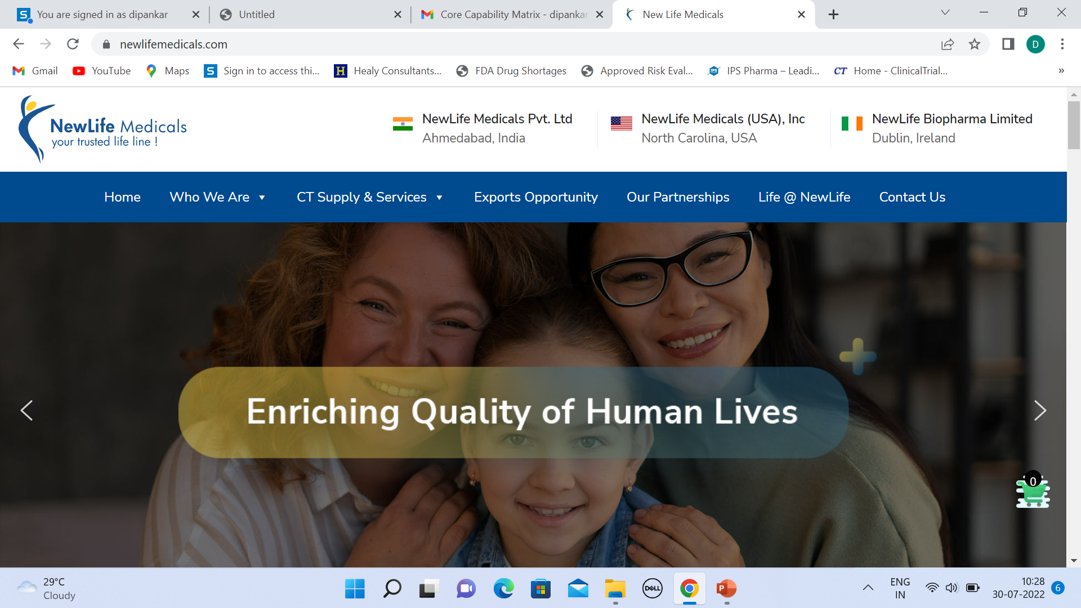
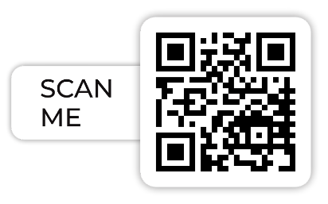
Visit us
NewLife Medicals - A SAP-ERP enabled Company
Engage with us : https://www.linkedin.com/company/newlifemedicals/mycompany/
Contact us :
US : +16106151483
India : +919727709706
Ireland : +353899768255
Mail us :
ankit@newlifemedicals.com

